Slide 1
MOTOR CONTROL A motor control circuit can be defined as a means of supplying power to and removing power from a motor.

Slide 2
Safety in the work place
Safety is the top priority in any job.
Many electrical accidents involve young workers due to carelessness, pressure, or lack of knowledge.
This chapter raises awareness of electrical hazards in workplaces and training facilities.

Slide 3
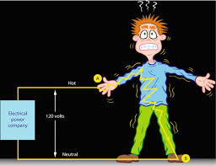
Electrical Shock
Electric shock is a common hazard in electrical work, occurring when a worker's body completes a circuit due to contact with a live conductor at an insulation failure point.

Slide 4
Elements of electricity and determining factors of electric shock severity
ELECTRICAL RESISTANCE (R) - Opposition to current flow, measured in ohms (Ω). Lower resistance increases current flow and shock risk.
BODY RESISTANCE - Can be divided into 2.
a. External (Skin Resistance) - Dry skin insulates, but moisture lowers resistance, increasing shock intensity.

Slide 5
Elements of electricity and determining factors of electric shock severity
b. Internal (Body Tissues And Blood Stream Resistance) - Body tissues and blood have low resistance due to salt and moisture, causing shock effects to vary by individual:
Dry skin—100,000 to 600,000 Ω
Wet skin—1,000 Ω
Internal body (hand to foot)—400 to 600 Ω
Ear to ear—100 Ω

Slide 6
Elements of electricity and determining factors of electric shock severity
Thin or wet skin lowers resistance, risking internal burns with minimal skin damage.
High skin resistance may cause severe burns but blocks current from reaching internal organs.

Slide 7
Elements of electricity and determining factors of electric shock severity
II. VOLTAGE ( E ) - The force driving electric current, measured in volts (V). Danger levels vary by individual, but voltages above 30V are generally hazardous.
Remember: Voltage alone doesn't determine shock intensity, as body resistance varies, making current unpredictable.

Slide 8
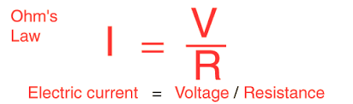
Elements of electricity and determining factors of electric shock severity
III. Electric current ( I ) - The flow of electrons, measured in amperes (A) or milliamperes (mA). Current through the body depends on voltage and resistance. Body current can be calculated using the following Ohm’s law formula:

Slide 9
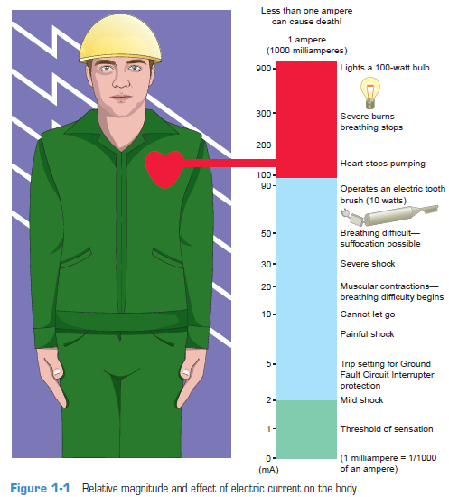
Elements of electricity and determining factors of electric shock severity
Remember: Shock intensity depends on current flow and exposure time. Once inside, current follows the circulatory system over the skin.

Slide 10
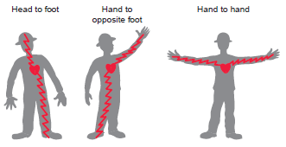
Elements of electricity and determining factors of electric shock severity
Remember: Shock severity depends on its pathway. A hand-to-foot current is more dangerous than one within the same arm, as it passes through the heart and nervous system.

Slide 11
Elements of electricity and determining factors of electric shock severity
Remember: The type of current affects shock severity.
AC (Alternating Current): 3-5 times more dangerous than DC at the same voltage and current. Low-frequency AC (50-60 Hz) causes muscle spasms and prolonged exposure.
DC (Direct Current): Causes muscle contractions, often throwing the victim away from the current source.

Slide 12
Elements of electricity and determining factors of electric shock severity
Remember: If a person suffers a severe shock, quickly disconnect them from the current safely. Do not touch the victim until the power is off. Only trained CPR (cardiopulmonary resuscitation)responders should attend to the victim immediately.

Slide 13


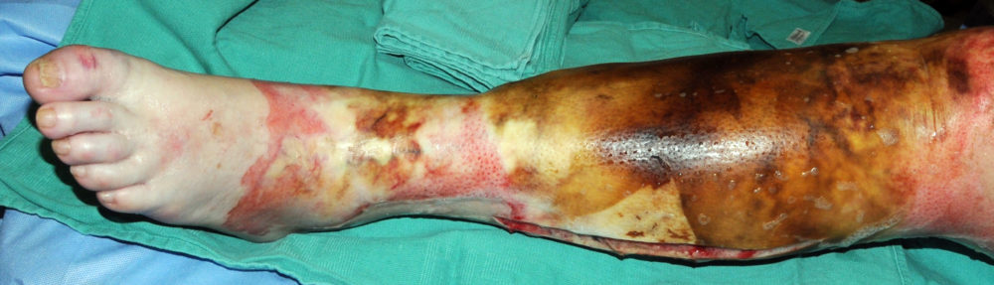
Major Types of burn
The most common electric-related injury is a burn. Below are the major types of burn:
Electrical burns, Caused by current flowing through tissues or bones, affecting skin or deeper layers.
Arc burns, Result from extremely high temperatures (up to 35,000°F) from electric arcs, often due to poor contact or insulation failure.
Thermal contact burns, Caused by contact with hot surfaces of overheated components or objects from an electric arc blast.

Slide 14
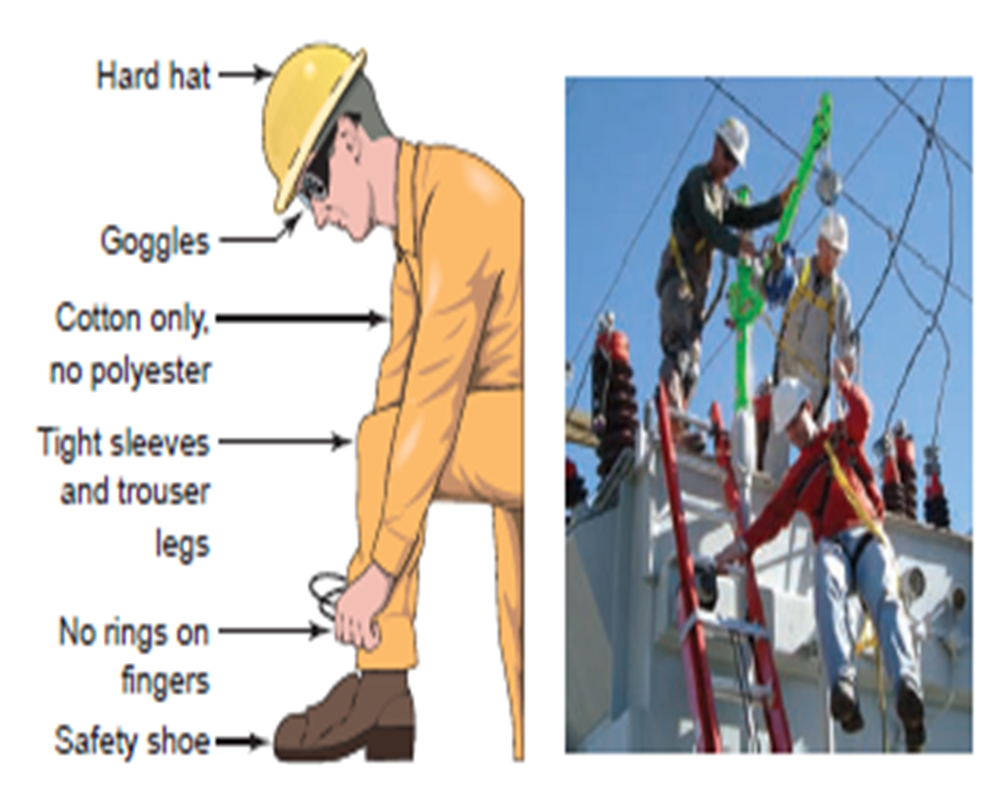
Personal protective equipment (ppe)
Wear appropriate attire for each job site and activity to ensure safety. The following points should be observed:
Wear hard hats, safety shoes, and goggles in specified areas; ensure hard hats are approved for electrical work. Metal hats are not acceptable!
Use safety earmuffs or earplugs in noisy environments.
Wear snug-fitting clothing to avoid entanglement; avoid synthetic fibers like polyester, as they can melt or ignite. Opt for cotton clothing.

Slide 15
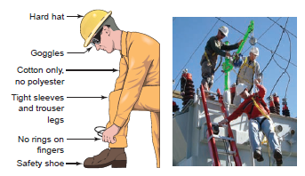
Personal protective equipment (ppe)
Remove all metal jewelry when working on energized circuits; gold and silver are excellent conductors of electricity.
Confine long hair or keep hair trimmed when working around machinery.

Slide 16
Personal protective equipment (ppe)
A variety of safety gear is available to prevent injury from live circuits.
Workers should know safety standards like NFP-70E and how to care for the equipment.
Inspect protective equipment for damage before each use and after any incident.

Slide 17

Personal protective equipment (ppe)
All electrical protection equipment must be listed and may include the following:
Rubber Protective Equipment
Rubber gloves prevent contact with energized circuits, protected by outer leather covers.
Rubber blankets shield workers from energized conductors when near exposed circuits.
Equipment must be marked with voltage rating and last inspection date.
Insulating gloves and blankets must match the circuit voltage; gloves require an air test for leaks—dispose if failed.

Slide 18

Personal protective equipment (ppe)
2. Protection Apparel
High-voltage sleeves, boots, and nonconductive helmets.
Nonconductive eyewear and face protection.
Switchboard blankets and flash suits.

Slide 19
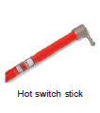
Personal protective equipment (ppe)
3. Hot Sticks
Insulated tools for operating high-voltage switches, fuse removal/insertion, and grounding.
Composed of a head (metal or plastic) and an insulating rod (wood, plastic, or other materials).

Slide 20
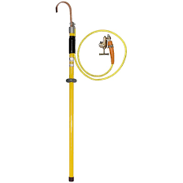
Personal protective equipment (ppe)
4. Shorting Probes
Used to discharge capacitors or static charges on de-energized circuits.
Should be attached as a safety precaution on high-voltage circuits.
Connect the test clip to a ground before installation; avoid touching metal parts while grounding.

Slide 21
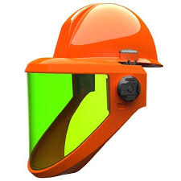
Personal protective equipment (ppe)
5. Face Shields
Wear during switching operations to protect against electrical arcs, flashes, or flying objects from explosions.

Slide 22
SAFE PRACTICES AND PROCEDURES
Always assume that a circuit is energized
Use the appropriate instrument for testing circuits
Use protective devices (ELCB, fuse, rubber mats, etc.)
Use personal protective equipment (rubber gloves, boots, safety devices).
Use warning signs and isolate dangerous areas.
Observe proper maintenance schedules of electrical equipment, loads and wires.
Do not use outlets or cords with exposed wiring
Do not use power tools when protective guards are removed
Do not block access to circuit breakers or fuse boxes.
Adhere to strictly established regulations of the Philippine Electrical Code.

Slide 23
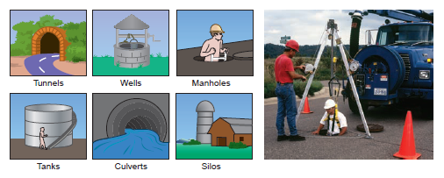
CONFINED SPACES
A “confined space” is an enclosed or partially enclosed space that:
Not intended for human occupancy.
Has restricted entrance or exit.
Poses health and safety risks due to design, location, materials, work activities, or hazards.

Slide 24
CONFINED SPACES
Remember: All hazards found in a regular workspace can also be found in a confined space. However, they can be even more hazardous in a confined space than in a regular worksite. Hazards in confined spaces can include:
Poor Air Quality
Fire Hazard
Noise
Moving Parts Of Equipment
Temperature Extremes
Poor Visibility
Barrier Failure Resulting In A Flood Or Release Of Free-flowing Solid
Remember: A “permit-required confined space” is a confined space that has specific health and safety hazards associated with it. Permit-required confined spaces require assessment of procedures in compliance with Occupational Safety and Health Administration (OSHA) standards prior to entry.

Slide 25
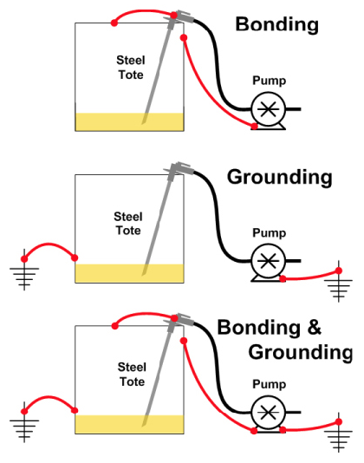
Grounding and bonding
Grounding
The intentional connection of a current-carrying conductor to the earth, typically on the line side of service equipment.
Reasons for grounding:
Limits voltage surges from lightning, utility operations, or accidental contact with higher-voltage lines.
Provides a stable ground reference for normal voltage conditions.
Helps overcurrent devices (circuit breakers, fuses, relays) operate during ground-fault conditions.

Slide 26
Grounding and bonding
Bonding:
Permanent joining of metal parts not meant to carry current, creating a conductive path for fault current.
Reasons for bonding:
Provides an effective path for fault current, aiding overcurrent protection devices.
Minimizes shock hazards by offering a low-impedance path to ground and limiting touch voltage during a ground fault.

Slide 27
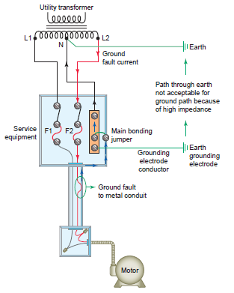
Grounding and bonding
Example of Grounding and Bonding in Motor Control
The ground-fault current path ensures overcurrent devices open the circuit.
Earth is not an effective ground-fault path due to high resistance.
The main bonding jumper connects the grounded service conductor and equipment grounding conductor at the service.
Bonding jumpers are used throughout the system, but the main bonding jumper is at the service.
Grounding is done via metal underground pipes, building frames, concrete-encased electrodes, or ground rings.

Slide 28
Grounding and bonding
A grounding system has two distinct parts: system grounding and equipment grounding.
System grounding is the electrical connection of one of the current carrying conductors of the electrical system to the ground.
Equipment grounding is the electrical connection of all the metal parts that do not carry current of all electrical equipment to the ground.

Slide 29
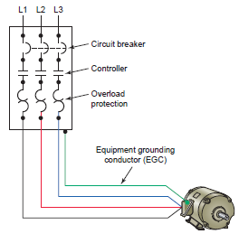
Grounding and bonding
Conductors that form parts of the grounding system include the following:
Equipment grounding conductor (EGC)
Provides a low-impedance ground path between electrical equipment and enclosures.
Grounds the motor frame to prevent injury from potential energization if motor insulation fails.
2. Grounded conductor is a conductor that has been intentionally grounded.
3. Grounding electrode conductor
Connects the equipment grounding conductor or grounded conductor to the grounding electrode(s).

Slide 30
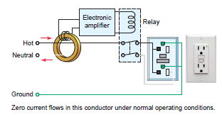
Grounding and bonding
Senses small ground-fault currents and shuts off the circuit within 1/40 second if leakage of 5mA is detected.
Provides overcurrent protection with 15-amp or larger fuses or circuit breakers for short circuits and overloads.

Slide 31
Grounding and bonding
According to OSHA, it is the employer’s responsibility to provide either:
Provide ground-fault circuit interrupters (GFCIs) for receptacle outlets on construction sites not part of permanent wiring.
Implement a scheduled, recorded assured equipment grounding conductor program for all portable cord sets, receptacles, and equipment used by employees.

Slide 32
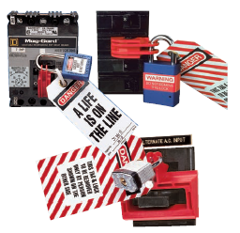
Lockout and tagout
Lockout: Disconnects electrical power and secures it with a lock to prevent re-energization.
Tagout: Attaches a danger tag to indicate the equipment must not be operated until the tag is removed.

Slide 33
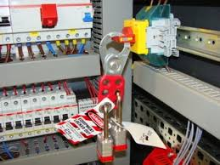
Lockout and tagout
Basic steps in Lockout and Tagout procedure:
Step 1: Prepare for machinery shutdown: Document all lockout procedures in a plant safety manual.
Step 2: Machinery or equipment shutdown: Stop all running equipment by using the controls at or near the machine.
Step 3: Machinery or equipment isolation: Disconnect the switch.
Step 4: Lockout and tagout application: Lock the disconnect switch in the OFF position. Tag the lock with the signature of the individual performing the repair and the date and time of the repair.

Slide 34
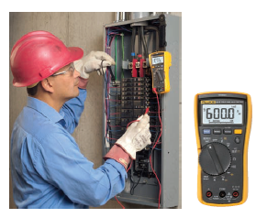
Lockout and tagout
Steps in removing Lockout and Tagout procedure:
Step 1: Release of stored energy: All sources of energy that have the potential to unexpectedly start up, energize, or release must be identified and locked, blocked, or released.
Step 2: Verification of isolation: Use a voltage test to determine that voltage is present at the line side of the switch or breaker. When all phases of outlet are dead with the line side live, you can verify the isolation.
Step 3: Lockout/tagout removal: Remove tags and locks when the work is completed.

Slide 35
Electrical codes and standards
OCCUPATIONAL SAFETY AND HEALTH ADMINISTRATION (OSHA)
Ensures safe working conditions by enforcing standards, assisting state programs, and providing research, education, and training.
OSHA inspectors verify compliance with safety regulations and approve safety products, focusing on protection from electric shock, electrocution, fires, and explosions.

Slide 36
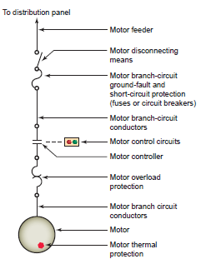
Electrical codes and standards
2. NATIONAL ELECTRICAL CODE (NEC)
A set of rules ensuring safe installation of electrical wiring and equipment.
Aims to safeguard people and property from electrical hazards.
Includes motor terminology used in the Code and by motor control equipment manufacturers.
Remember: NEC provided the set of rules we are
using in designing and reading ladder diagrams
and single-line diagrams.

Slide 37
Electrical codes and standards
3. NATIONAL FIRE PROTECTION ASSOCIATION (NFPA)
Develops fire safety codes, including the National Electrical Code, to prevent loss of life and property.
4. NATIONALLY RECOGNIZED TESTING LABORATORY (NRTL)
Tests electrical products for compliance with national codes before listing or labeling, as required by OSHA.

Slide 38
Electrical codes and standards
5. NATIONAL ELECTRICAL MANUFACTURERS ASSOCIATION (NEMA)
Based in North America, defines and recommends safety standards for electrical equipment.
NEMA standards help in selecting industrial control equipment, covering ratings, testing, performance, and manufacturing of devices like enclosures, contactors, and starters.

Slide 39
Electrical codes and standards
6. INTERNATIONAL ELECTROTECHNICAL COMMISSION (IEC)
A Europe-based organization made up of national committees from over 60 countries.
Provides standards in metric units for the rating, testing, performance, and manufacture of motor control devices, similar to NEMA.

Slide 40
Electrical codes and standards
7. INSTITUTE OF ELECTRICAL AND ELECTRONICS ENGINEERS (IEEE)
A professional association focused on advancing electrical and electronic standards.
IEEE produces over 30% of global electrical and electronic engineering literature and offers standards like IEEE Standard 142 for grounding design.

Slide 41
END of Chapter 1

